Slide 1
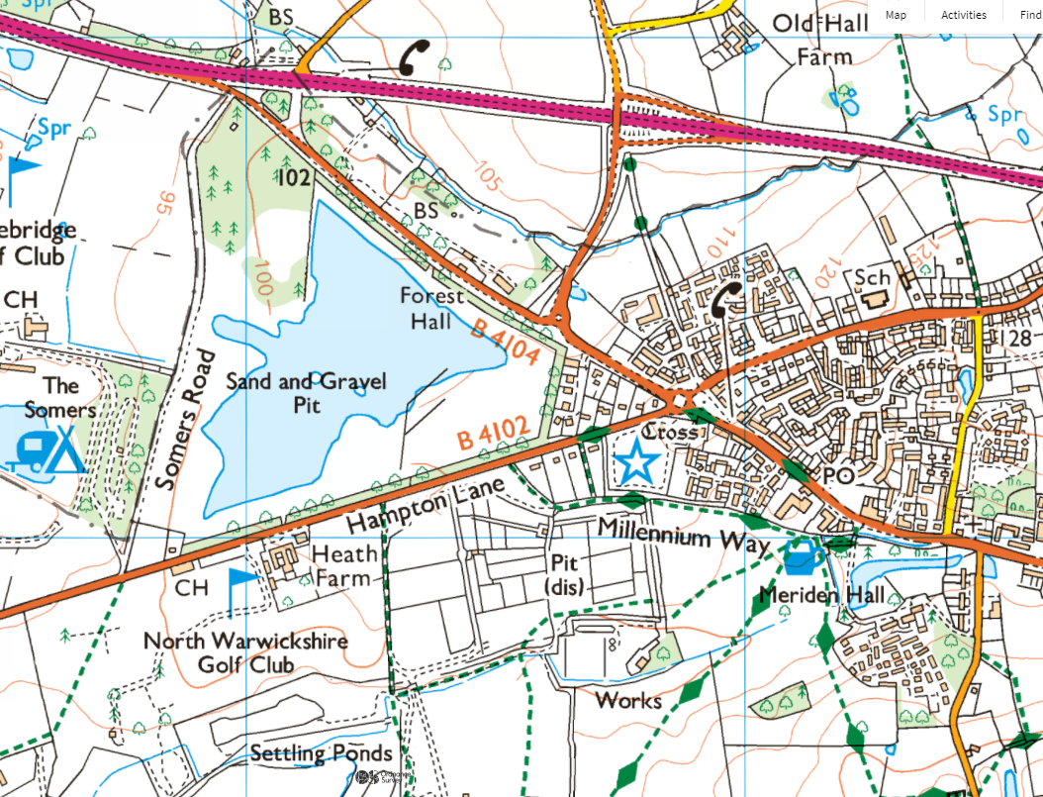
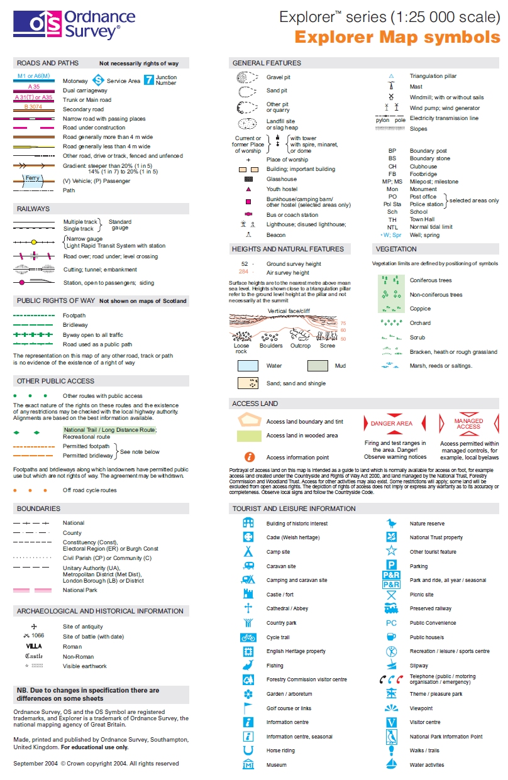
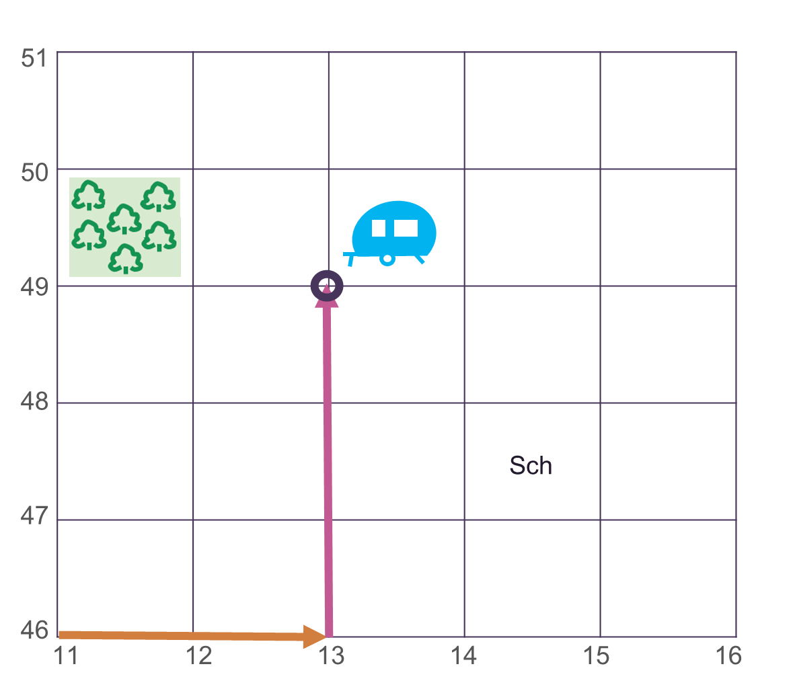
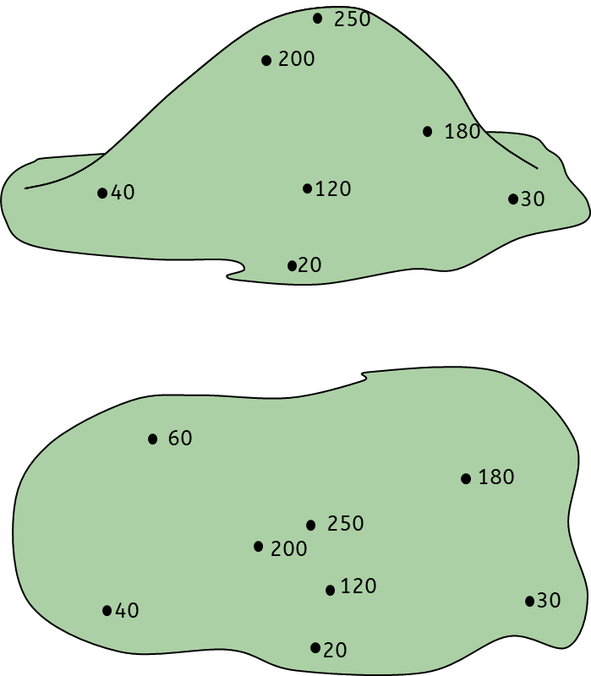
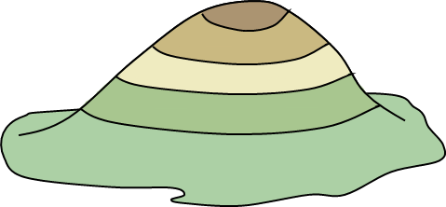
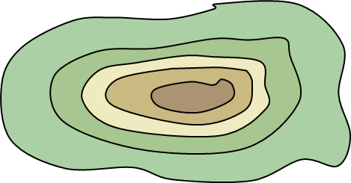
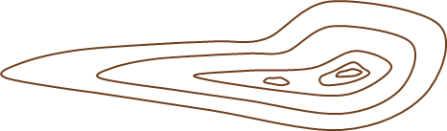
Introduction to geographical skills
Maps and symbols
OS maps use symbols to show human and physical features. Maps have a title, labels, a compass rose, a scale and a key.
Four-figure grid references
Four-figure grid references are used to describe locations on an OS map.
Look at the bottom-left corner of the square.
Find the easting.
Find the northing.
Write down the four-figure grid reference.
Key vocabulary
Relief
Continent – One of the seven large land masses on Earth
Longitude – The lines down the earth showing east or west
Latitude – The lines across the earth showing north and south
Eastings – The grid reference along the bottom
Northings – The grid reference up the side
Contour lines – Brown lines on a map that show height
Relief – The height of the land
Topography - The shape and physical features of an area
Altitude - Height above sea level (measured in metres).
OS map – Ordnance Survey is a map of areas of the UK
Height on a 2D map can be shown using three methods:
Spot heights – a dot giving the exact height of a specific point.
Colour layering - different heights are shown by bands of different colours.
Contour lines – brown lines connecting areas of the same height.
Geography | 7.01 – Introduction to map skills | Knowledge Organiser
Notes:
Images
Scale (CCO) - https://commons.wikimedia.org/wiki/File:Scale_kilometres_miles.svg
OS map data (© Crown copyright ) - https://explore.osmaps.com/location?lat=52.438393&lon=-1.659061&zoom=14.5560&style=Leisure&type=2d&locationName=U2FsdGVkX1%2BUlocJejMa8nY7mBPU9MrKluCg3%2BPBUcQ%3D&locationCoordinates=-0.6098437645336163%2C52.459120647858285&locationBbox=-0.6199%2C52.4517%2C-0.6008%2C52.4638
All other images – United Learning

Slide 2


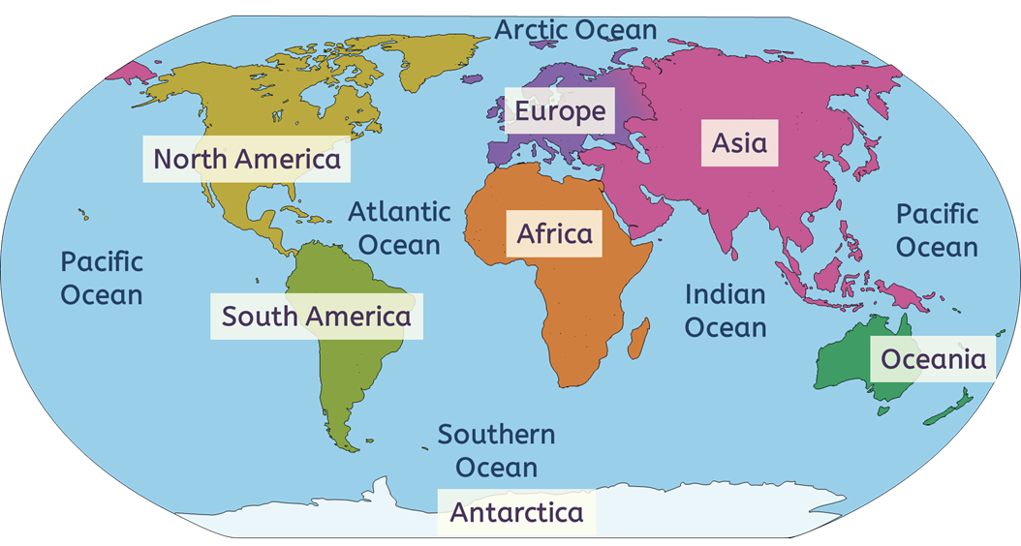
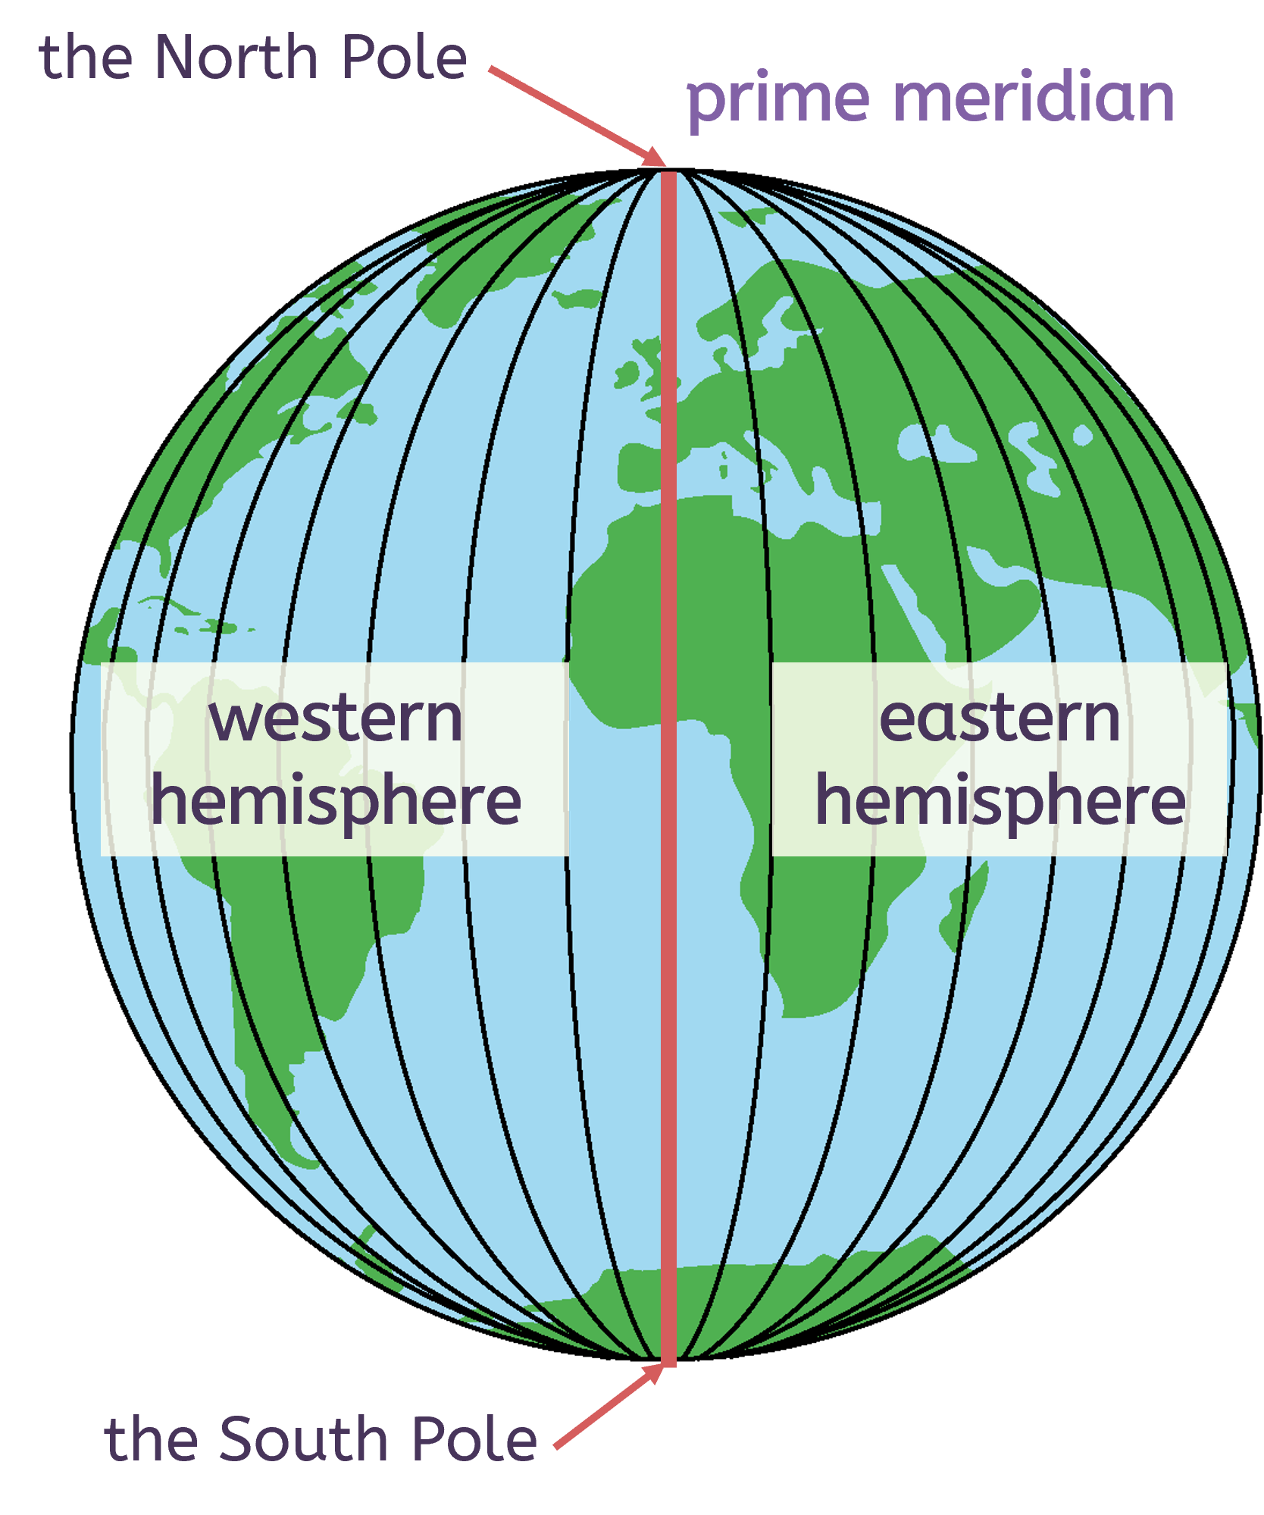
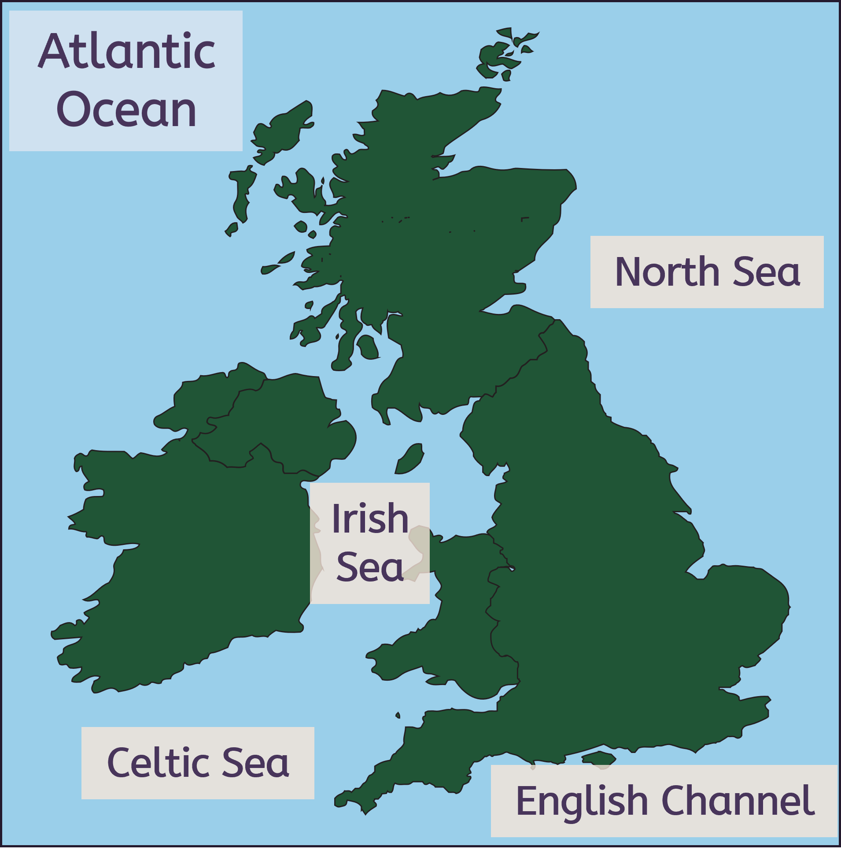
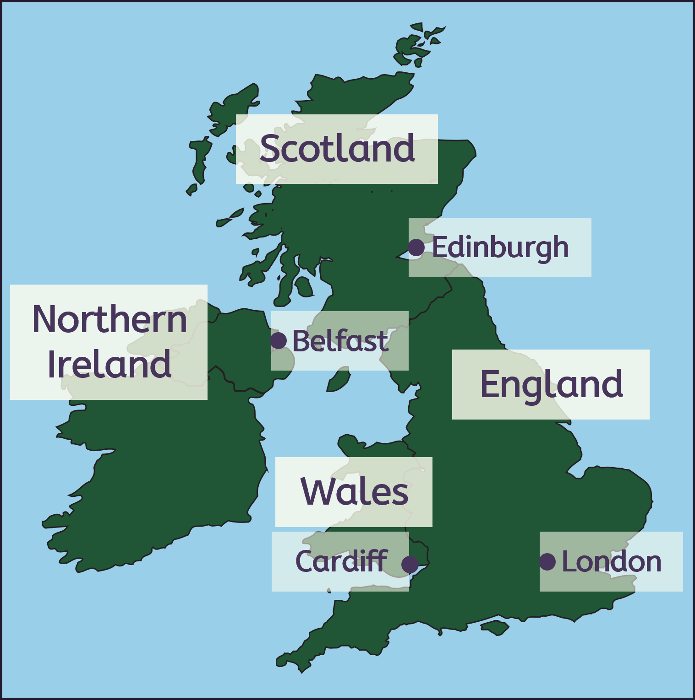
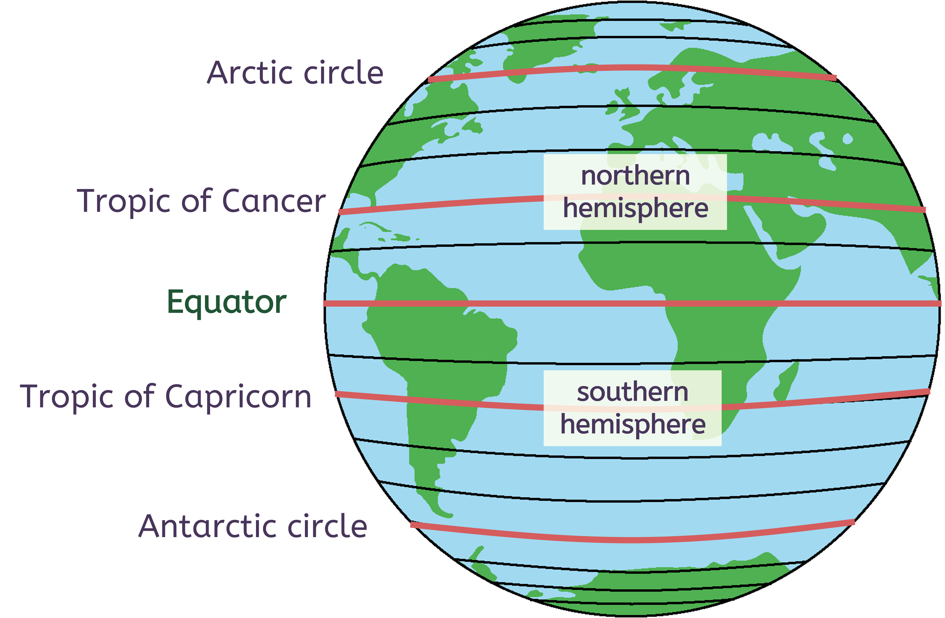
Introduction to geographical skills
North
Northwest
Northeast
Continents, oceans and countries in the UK
West
East
Southwest
Southeast
South
Longitude and latitude
Longitude
Latitude
Notes:
Images
All images – United Learning

